Slide 1
MODERN OPERATING SYSTEMS
Third Edition
ANDREW S. TANENBAUM
Chapter 12
Case Study 3: Symbian OS
Tanenbaum, Modern Operating Systems 3 e, (c) 2008 Prentice-Hall, Inc. All rights reserved. 0-13-6006639

Slide 2
The History of Symbian OS
Symbian OS Roots
  Psion and EPOC
Symbian OS Version 6
Symbian OS Version 7
Symbian OS Today
Tanenbaum, Modern Operating Systems 3 e, (c) 2008 Prentice-Hall, Inc. All rights reserved. 0-13-6006639

Slide 3
An Overview of Symbian OS
Object Orientation
Microkernel Design
The Symbian OS Nanokernel
Client/Server Resource Access
Features of a Larger Operating System
Communication and Multimedia
Tanenbaum, Modern Operating Systems 3 e, (c) 2008 Prentice-Hall, Inc. All rights reserved. 0-13-6006639

Slide 4
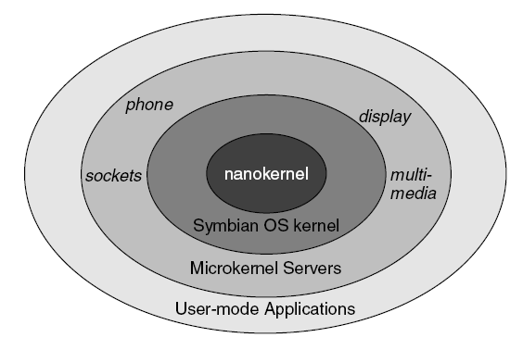
Client/Server Resource Access
Figure 12-1. The Symbian OS kernel structure has many layers.
Tanenbaum, Modern Operating Systems 3 e, (c) 2008 Prentice-Hall, Inc. All rights reserved. 0-13-6006639

Slide 5
Features of a Larger Operating System
Processes and threads
Common file system support
Networking
Memory management
Tanenbaum, Modern Operating Systems 3 e, (c) 2008 Prentice-Hall, Inc. All rights reserved. 0-13-6006639

Slide 6
Processes And Threads in Symbian OS
Threads and Nanothreads
Processes
Active Objects
Interprocess Communication
Tanenbaum, Modern Operating Systems 3 e, (c) 2008 Prentice-Hall, Inc. All rights reserved. 0-13-6006639

Slide 7
Threads and Nanothreads
Nanothreads can be in the following states:
Suspended
Fast semaphore wait
DFC wait
Sleep
Other
Tanenbaum, Modern Operating Systems 3 e, (c) 2008 Prentice-Hall, Inc. All rights reserved. 0-13-6006639

Slide 8
Systems with No Virtual Memory
Memory management consists of the following tasks:
Management of application size
Heap management
Execution in-place
Loading DLLs
Offload memory management to hardware
Tanenbaum, Modern Operating Systems 3 e, (c) 2008 Prentice-Hall, Inc. All rights reserved. 0-13-6006639

Slide 9
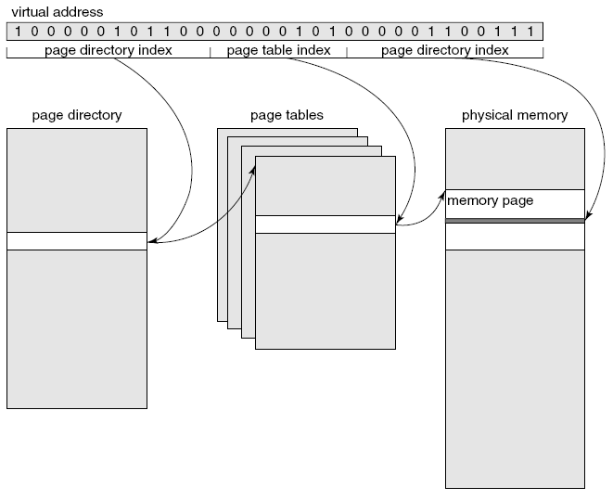
How Symbian OS Addresses Memory
Figure 12-2. Symbian OS uses a two-level page table to reduce table access time and storage.
Tanenbaum, Modern Operating Systems 3 e, (c) 2008 Prentice-Hall, Inc. All rights reserved. 0-13-6006639

Slide 10
Memory Implementation
Versions of memory implementation:
The moving model
The multiple model
The direct model
The emulator model
Tanenbaum, Modern Operating Systems 3 e, (c) 2008 Prentice-Hall, Inc. All rights reserved. 0-13-6006639

Slide 11
Input and Output
Device Drivers
Kernel Extensions
Direct Memory Access
Special Case: Storage Media
Blocking I/O
Removable Media
Tanenbaum, Modern Operating Systems 3 e, (c) 2008 Prentice-Hall, Inc. All rights reserved. 0-13-6006639

Slide 12
Removable Media
Features common to removable media:
All devices must be inserted and removed.
All removable media can be removed ‘‘hot,’’ that is, while being used.
Each medium can report its capabilities.
Incompatible cards must be rejected.
Each card needs power.
Tanenbaum, Modern Operating Systems 3 e, (c) 2008 Prentice-Hall, Inc. All rights reserved. 0-13-6006639

Slide 13
Storage Systems
File Systems for Mobile Devices
Symbian OS File Systems
File System Security and Protection
Tanenbaum, Modern Operating Systems 3 e, (c) 2008 Prentice-Hall, Inc. All rights reserved. 0-13-6006639

Slide 14
Security in Symbian OS (1)
Steps when an application requires signing:
The software developer must obtain a vendor ID from a trusted third party.
When developer has developed software package, wants to distribute, developer must submit package to trusted third party for validation.
. . .
Tanenbaum, Modern Operating Systems 3 e, (c) 2008 Prentice-Hall, Inc. All rights reserved. 0-13-6006639

Slide 15
Security in Symbian OS (2)
Trusted third party then verifies that list of software access types is complete and no other type of access occurs.
Installation package sent back to the software developer and may now be distributed to users.
Tanenbaum, Modern Operating Systems 3 e, (c) 2008 Prentice-Hall, Inc. All rights reserved. 0-13-6006639

Slide 16
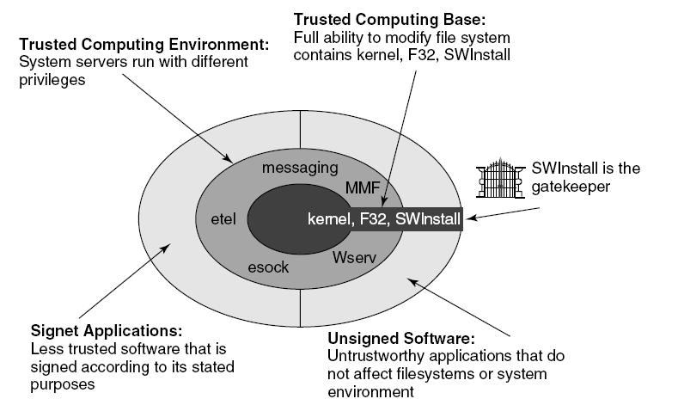
Security in Symbian OS (3)
Figure 12-3. Symbian OS uses trust relationships
to implement security.
Tanenbaum, Modern Operating Systems 3 e, (c) 2008 Prentice-Hall, Inc. All rights reserved. 0-13-6006639

Slide 17
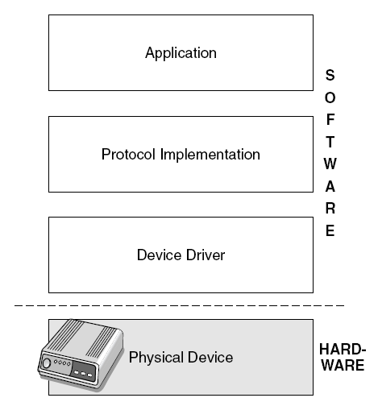
Communication in Symbian OS
Figure 12-4. Communication in Symbian OS
has block oriented structure.
Tanenbaum, Modern Operating Systems 3 e, (c) 2008 Prentice-Hall, Inc. All rights reserved. 0-13-6006639

Slide 18
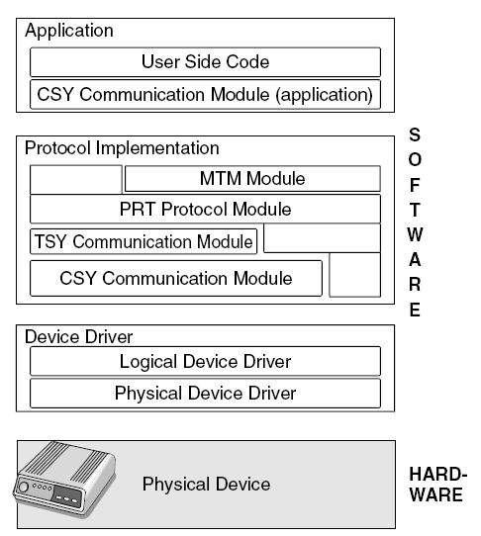
Infrastructure – The Physical Device
Figure 12-5. Communication structure in Symbian
OS has a rich set of features.
Tanenbaum, Modern Operating Systems 3 e, (c) 2008 Prentice-Hall, Inc. All rights reserved. 0-13-6006639

Slide 19
The Protocol Implementation Layer
CSY Modules
TSY Modules
PRT Modules
MTMs
Tanenbaum, Modern Operating Systems 3 e, (c) 2008 Prentice-Hall, Inc. All rights reserved. 0-13-6006639

